Slide 1
Router Configuration and Static Routing CS F303
Dr. Pranav M. Pawar

Slide 2
Packet Tracer
Packet Tracer is a program used to illustrate how computer networks work.
Packet Tracer has two different views
Logical Workspace
Physical Workspace
Packet Tracer also has two modes of operation
Realtime Mode
Simulation Mode

Slide 3
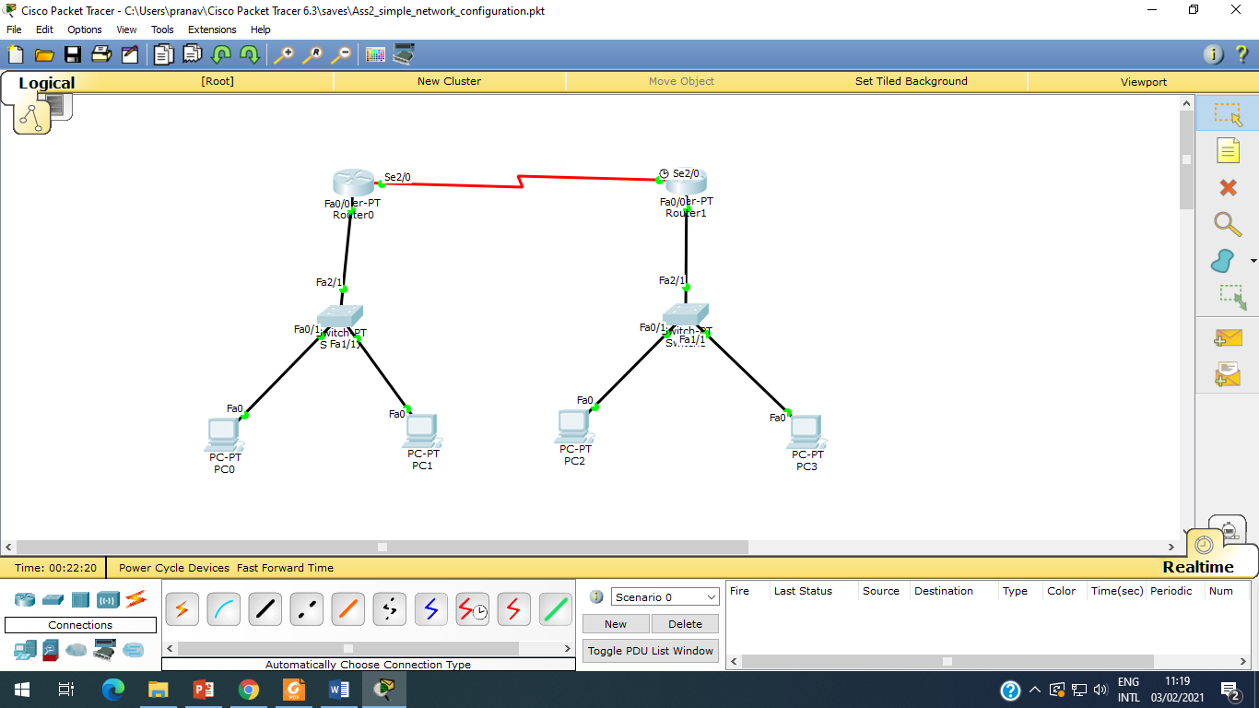
Topology

Slide 4
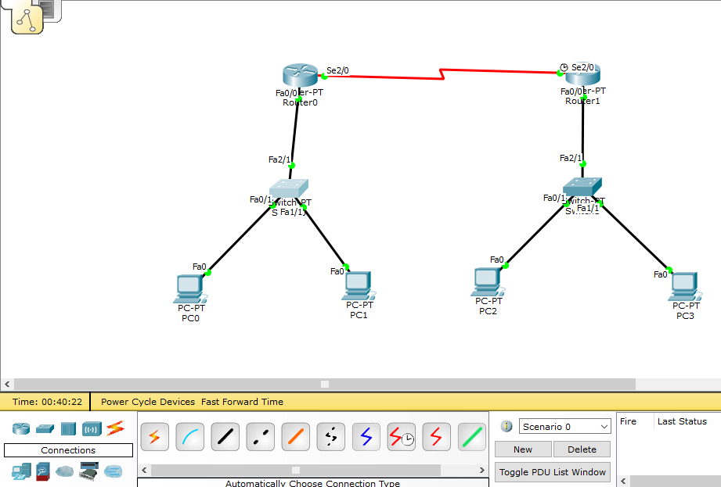
Create Network
Drag and drop the required components from the Packet Tracer component toolbox
Component toolbox

Slide 5
Assign addressed to Connections
Device | Connected from | Connected to | IP Address
PC0 | FastEthernet 0 | Switch0 FastEthernet 0/1 | 10.0.0.2
PC1 | FastEthernet 0 | Switch0 FastEthernet 1/1 | 10.0.0.3
Router0 (Gateway) | Switch0 FastEthernet 2/1 | Router0’s FastEthernet 0/1 | 10.0.0.1
Router0 | Serial 2/0 | Router1’s Serial 2/0 | 192.168.0.253
Router1 | Serial 2/0 | Router0’s Serial 2/0 | 192.168.0.254
Router1 (Gateway) | Switch1 FastEthernet 2/1 | Router1’s FastEthernet 0/1 | 20.0.0.1
PC2 | FastEthernet 0 | Switch1 FastEthernet 0/1 | 20.0.0.2
PC3 | FastEthernet 0 | Switch1 FastEthernet 1/1 | 20.0.0.3
IP Address and Default Mask

Slide 6
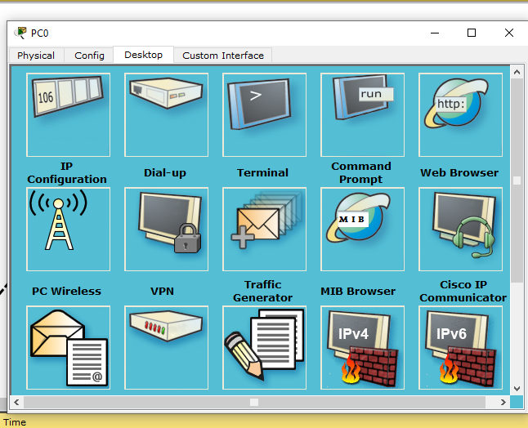
Assign IP Address PC (1)
Assign IP address to PC0.
Step 1: Click on PC0, we will get following window.

Slide 7
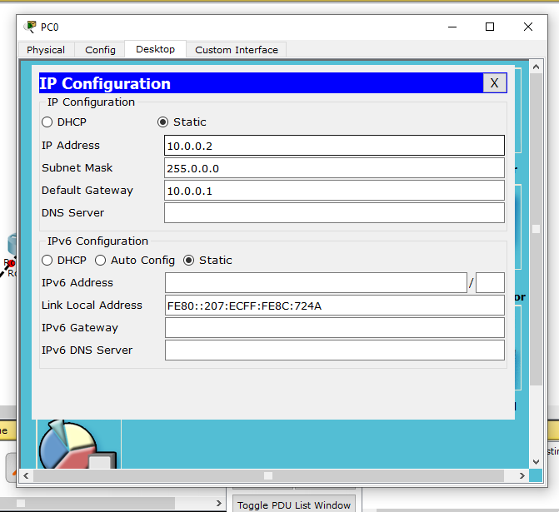
Assign IP Address PC (2)
Assign IP address to PC0.
Step 2: Click on IP configuration and set the IP address, subnet mask and gateway address.
Assign IP address to PC1, PC2, and PC3 in same way.

Slide 8
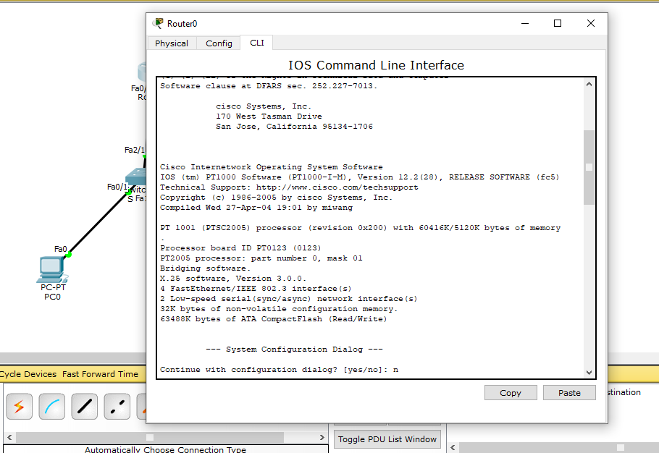
Configuring Router 0 (1)
Step1: Double click Router0 and click CLI and press Enter key to access the command prompt of Router0.
Press N in Continue with configuration dialog? [yes/no]:

Slide 9
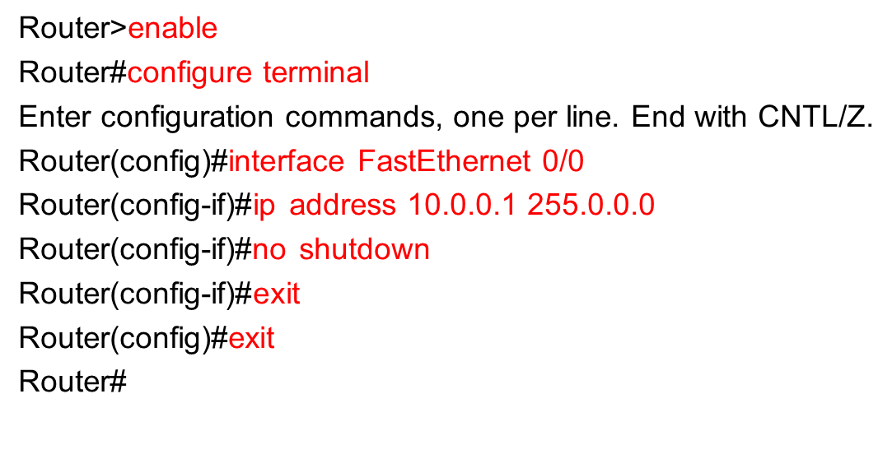
Configuring Router (2)
Step 2: Use following commands to configure Router 0, FastEthernet 0/0 interface.

Slide 10
Configuring Router 0 (2)
Step 2: Use following commands to configure Router 0, Serial 2/0 interface.
Router#configure terminal
Router(config)#interface Serial2/0
Router(config-if)#ip address 192.168.0.253 255.255.255.0
Router(config-if)#no shutdown
Router(config-if)#exit
Router(config)#exit
Router#

Slide 11
Configuring Router 1
In same way, Configure Serial 2/0 and FastEthernet 0/0 interface.
Router>enable
Router#configure terminal
Enter configuration commands, one per line. End with CNTL/Z.
Router(config)#interface FastEthernet0/0
Router(config-if)#ip address 20.0.0.1 255.0.0.0
Router(config-if)#exit
Router(config)#interface FastEthernet0/0
Router(config-if)#no shutdown
Router(config-if)#exit
Router(config)#interface Serial2/0
Router(config-if)#ip address 192.168.0.254 255.255.255.0
Router(config-if)#no shutdown
Router(config-if)#exit
Router(config)#exit
Router#

Slide 12
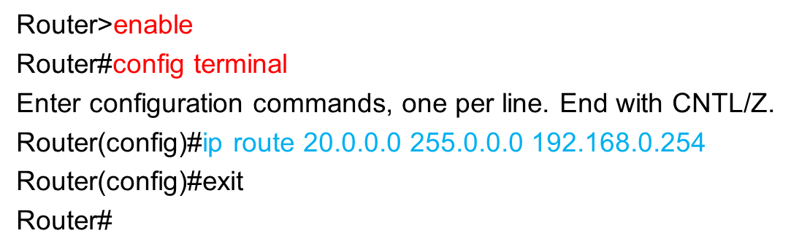
Configure Routing (1)
For Router 0: Instructs router that when you receive a packet for 20.0.0.0 network give it to 192.168.0.254.

Slide 13
Configure Routing (2)
For Router 1: Instructs router that when you receive a packet for 10.0.0.0 network give it to 192.168.0.253.
Router>enable
Router#configure terminal
Enter configuration commands, one per line. End with CNTL/Z.
Router(config)#ip route 10.0.0.0 255.0.0.0 192.168.0.253
Router(config)#exit
Router#

Slide 14
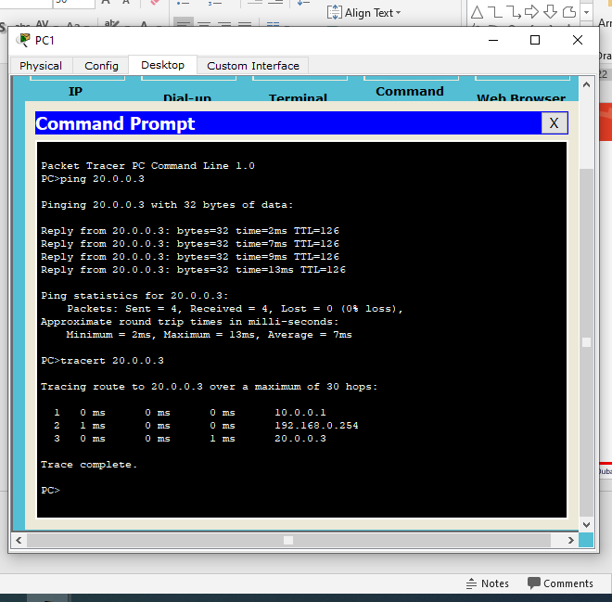
Communication from PC1 to PC3
Ping and tracert from PC1 to PC3

Slide 15
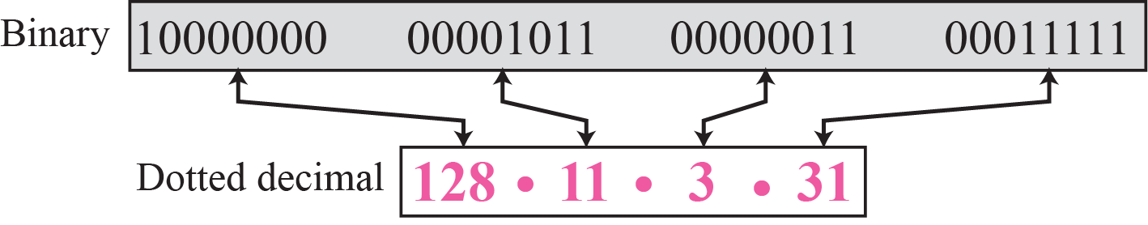
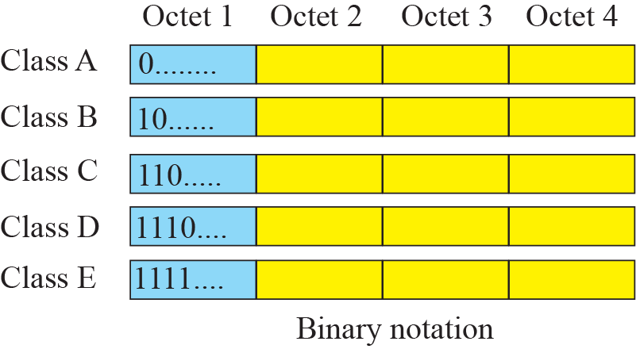
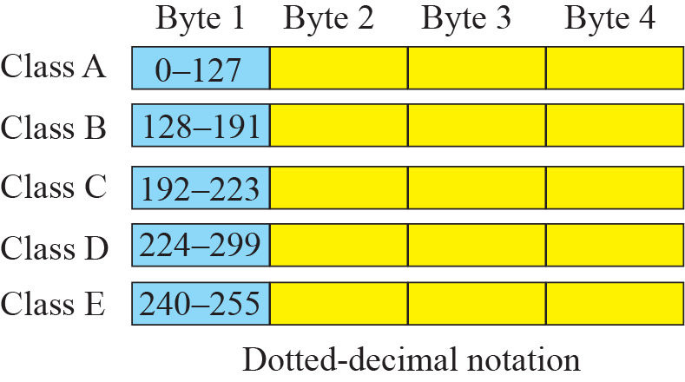
Appendix (1)
IPv4 Address
Classes of IPv4 Address

Slide 16
Appendix (2)
Netid and hostid

Slide 17

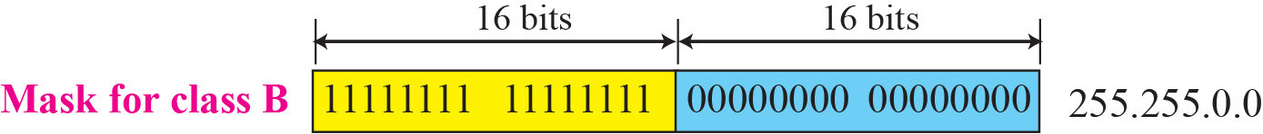

Appendix (3)
Default Mask

Slide 18
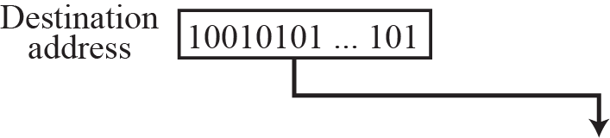
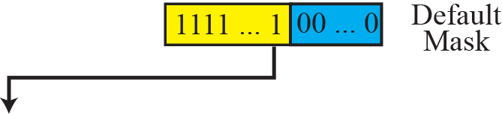
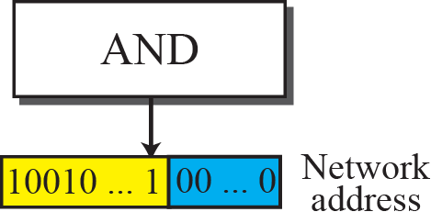
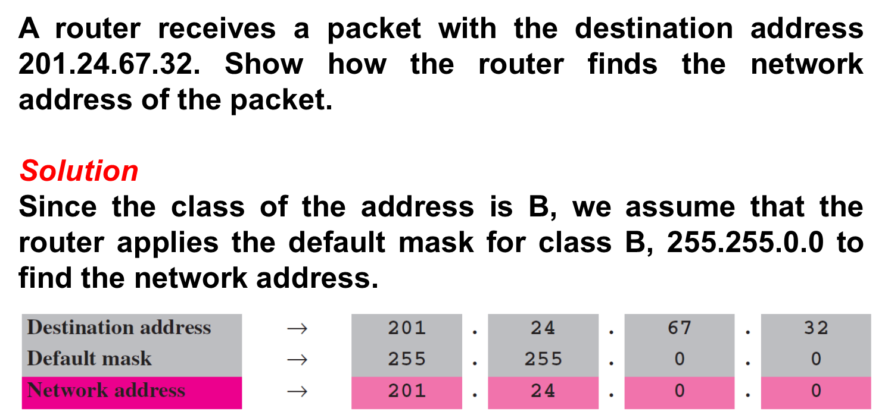
Appendix (4)
Finding a network address using the default mask
Example:

Slide 19
Thank You!

